Slide 1

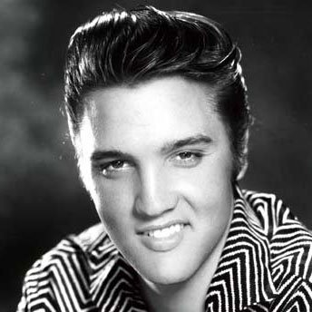
AKA ‘Rubberduckin’
by me (Adam Pisky-Nagy)
Rubber duck debugging

Slide 2
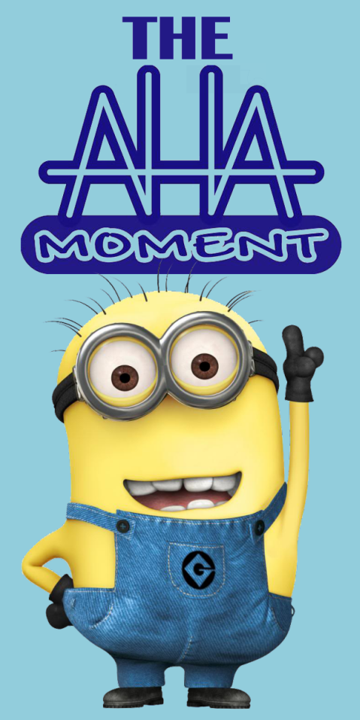
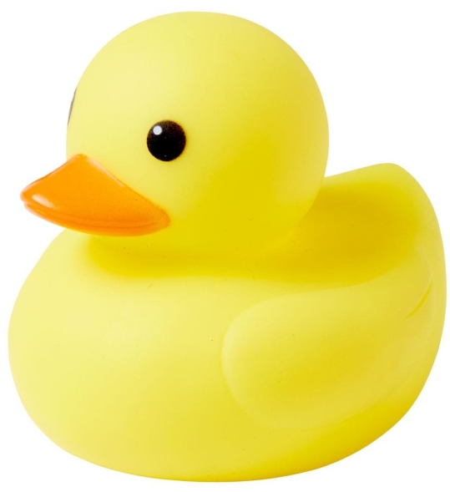

Science & definition
+
=

Slide 3
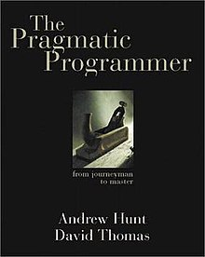
Origins The Pragmatic Programmer
‘The Pragmatic Programmer’, by Andrew Hunt, David Thomas (1999)
Collection of tips
Analogies and short stories
Main qualities of a programmer:
early adopter,
critical thinking,
realism,
jack-of-all-trades

Slide 4
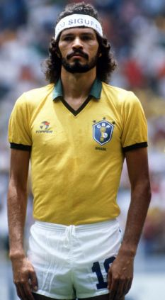

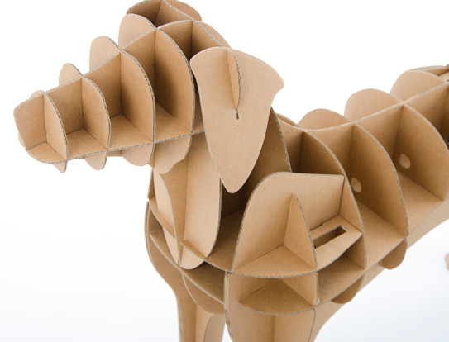
Origins
‘The Practice of Programming’ (1999), by Brian Kernighan and Rob Pike
‘The Contribution of the Cardboard Cutout Dog to Software Reliability and Maintainability’
Socratic method
Piaget's theory of cognitive development

Slide 5
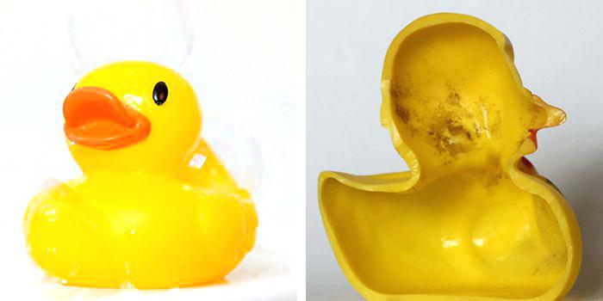
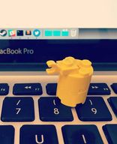

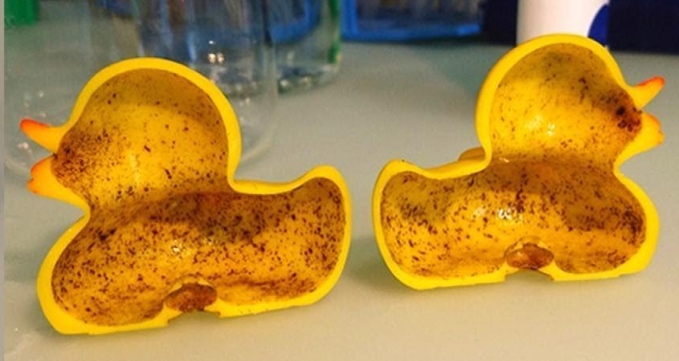
Anatomy

Slide 6
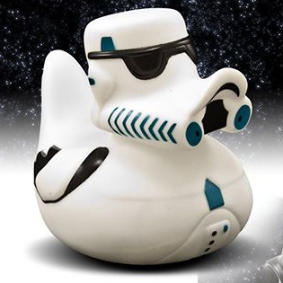
Source of the problem
Not thinking like a computer does…
…and you know exactly what you want to do…
…but the computer doesn’t.

Slide 7
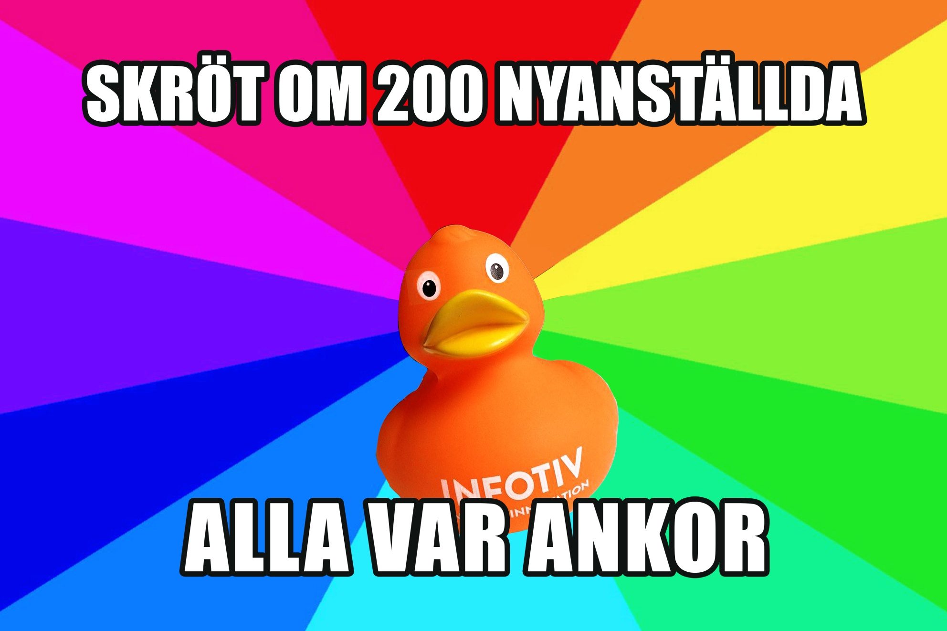
Source of the problem
We think faster than we talk…
…which creates room for error…
…and ignorance to the problematic part.
(especially if it’s a mundane one)

Slide 8
Concept
Recruit a:
Inamite object
Pet
Person who has no knowledge of the topic
Colleague
Speechless children
Teaching the duck
Talk to yourself (and the duck)
Force yourself to assess the situation from the outside

Slide 9
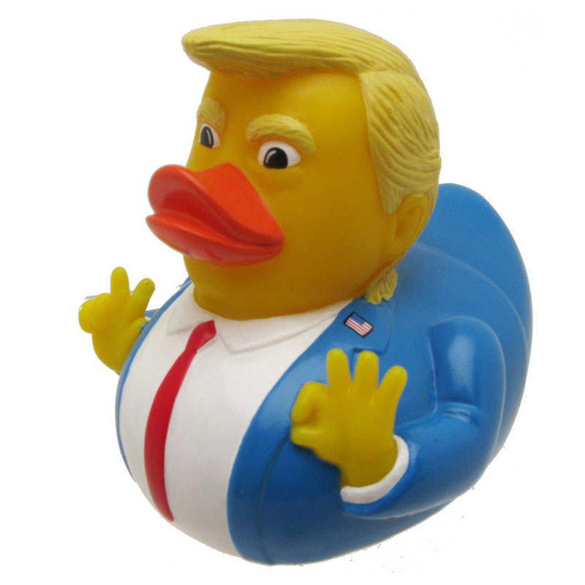
Concept
Looking at the code with a fresh set of eyes
Make a serious attempt to solve the issue yourself
Ask thorough, detailed questions
Access information that’s already stored in your head
Different perspective

Slide 10
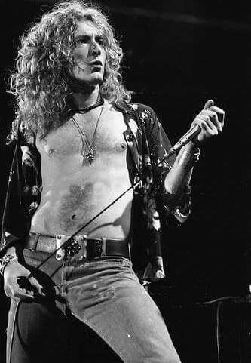
Synonyms
Teddy bear programming
Confessional debugging
Rubber plant debugging
Cardboard programmer / programmer’s dummy / cardboard collegue
Cone of answers
Frog debugging
Or…
..thinking out loud..and other not-so-exciting names

Slide 11
Walkthrough
GET DUCK!
Explain your (broken) code and its goals, generally. Don’t worry about details, just set the context for your duck.
Line-by-line, explain what the flow of the whole function or method that’s not working is. Don’t skip details, ducks love details!
If your duck friend hasn’t spotted it yet, be sure to explain all the intermediate states and transitions in detail.
Find your (stupid, obvious) solution! The reason we so love “rubber duck debugging” is that (typically) in the process of doing this, you’ll find your problem. You made a small typo. You were operating on the wrong variable. Your if condition was checking the opposite of what you thought. Something is likely to be revealed.
ASSESS PROBLEM!
OPEN MOUTH!
SOLVE PROBLEM!
THANK
D
U
C
K
!!!

Slide 12
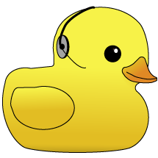
Ask for help!
https://rubberduckdebugging.com/

Slide 13
Quack! Quack!

